Slide 1
Design and Integration of an Ecological Momentary Assessment and Intervention of ACT for Smoking Cessation in those with Chronic Mental Illness (CMI)
Javier Rizo, B.A., Psychiatry & Behavioral Sciences
Roger Vilardaga, Ph.D., Psychiatry & Behavioral Sciences
Julie Kientz, Ph.D., Human Centered Design & Engineering
Richard Ries, M.D., Psychiatry & Behavioral Sciences
Notes:
Hi, today I’m going to be talking to you about the process of developing an EMA-EMI integrated feature as part of a smoking cessation app for people with serious mental illness. I’ll also present some preliminary user data on engagement. Based on what we’ve learned, we’ll share some of our recommendations for designing EMA features within the app.

Slide 2
Disclosure Of Financial Support
This study was funded by a grant from National Institute of Drug Abuse
(1 K99DA03727601) PI: Roger Vilardaga, PhD
None of the authors have received any commercial support related to this presentation or the work presented in this presentation.
Notes:
This project is funded by a K award from the National Institute of Drug Abuse

Slide 3


EMA, Smoking & Mobile Technology
EMA & serious psychopathology
  More vulnerable to recall bias
mHealth’s wide-reach
  Smartphone use among those with CMI
Smoking among those with Chronic Mental Illness (CMI)
  Major public and personal health costs
  General lack of treatment access
Notes:
We consider EMAs to be conceptually consistent with contextual behavioral science. They can be especially useful with the chronically mentally ill to better assess behavior, which can lead to better interventions. Global self-report measures are particularly problematic for this population, as they typically show higher levels of cognitive deficits (Vilardaga).
Improving smoking rates could have a large impact on improving the health of this underserved population. Functional analysis of smoking behaviors is especially well-suited for EMAs (Shiffman, 201)
By utilizing smartphones, as more people in this population adopt them, mHealth technologies have wider reaching potential (Ben-Zeev).

Slide 4


Ecological Momentary Interventions (EMI)
Delivery through smartphones
  Highly portable, frequently used device
EMAs for tailored interventions
  Ecologically relevant and convenient
Importance of design
  Maximize engagement with target users
Notes:
mHealth and EMI
Ecological momentary interventions can be delivered through mobile devices like smartphones, which have such a large presence in our daily lives.
By taking EMA data and tailoring the EMI, we can provide wiser interventions when urges arise in users’ lives (Heron et al, 2010; Walton, 2014). These could also help generalize skills learned previously.
(3) However, effectively integrating EMAs with EMIs requires careful attention to their design. If users find the mHealth interface to be burdensome, confusing, or unengaging this can be disastrous to the EMI’s effectiveness.

Slide 5

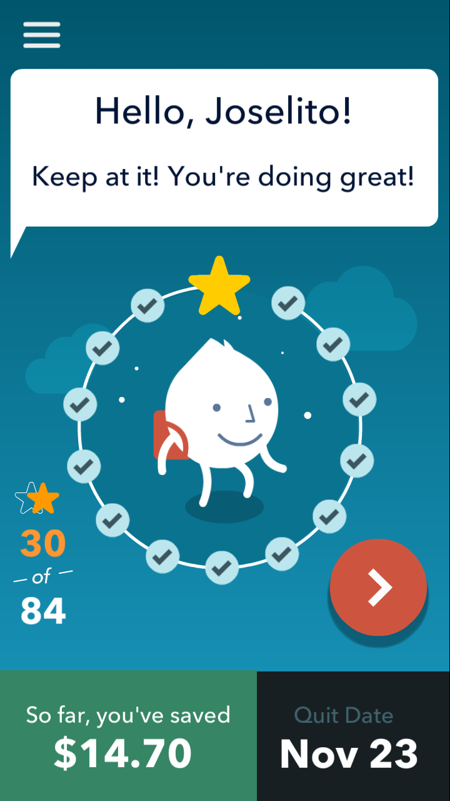
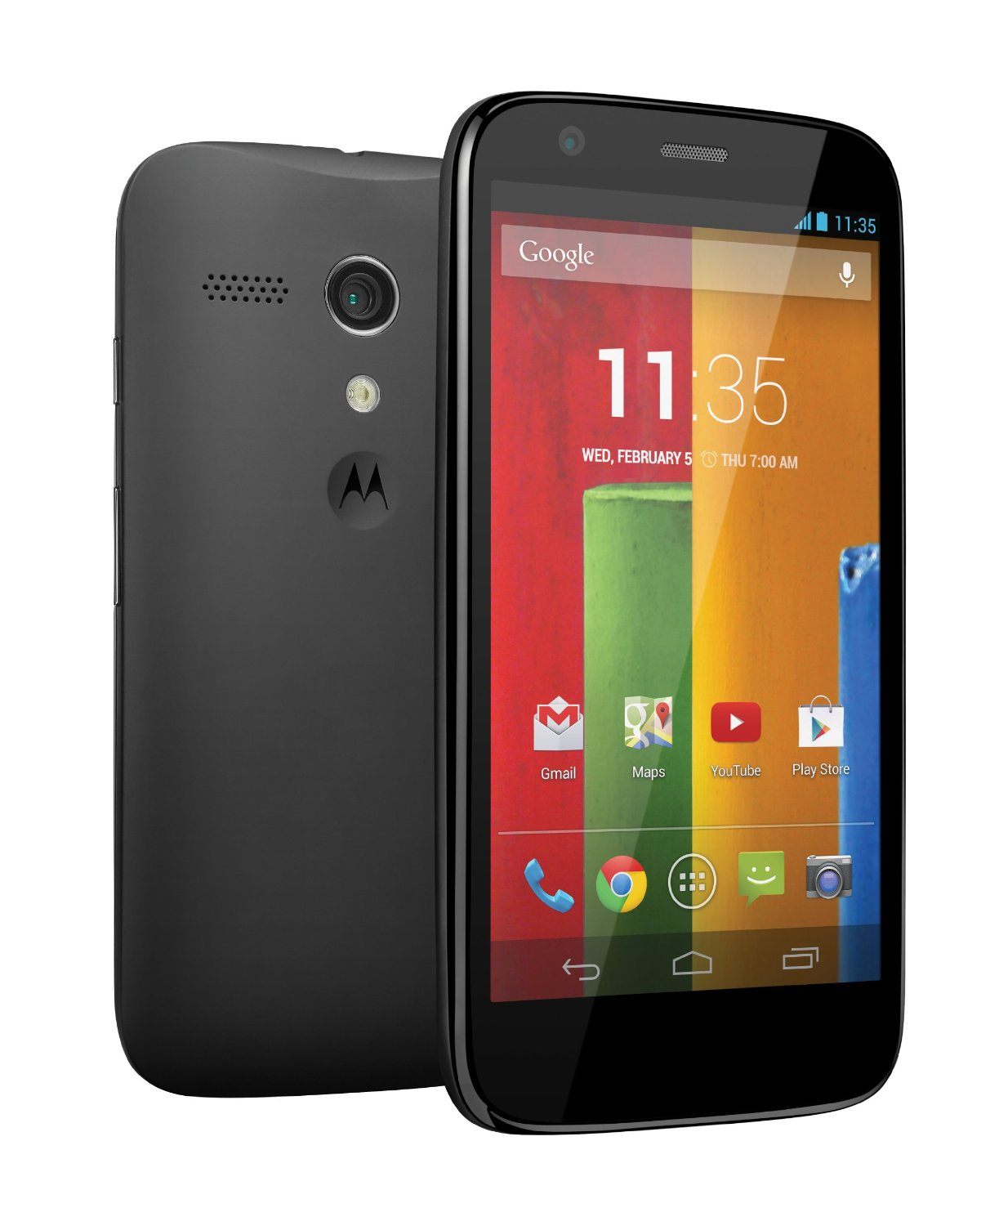
Learn to Quit (LtQ)
Smoking cessation app (Android) for CMI
  User experience (UX) evaluation of QuitPal and paper prototypes of LtQ
ACT interventions with a motivational component
  Enhance user experience with Learn, Practice, and Play
Notes:
We utilized EMA and EMIs within a smoking cessation smartphone app we created called “Learn to Quit”– which is based on contextual behavior science, ACT, and user-centered design.
It was developed from insights gained of an earlier user experience or “UX” evaluation. We initially used QuitPal (an earlier app developed by the National Cancer Institute) to test with our target users, and after that early paper prototypes for Learn to Quit.
Interventions targeting ACT processes that relate to smoking behavior, are incorporated throughout the app. Users follow their “north stars” for quitting through the “swamp of urges” to get to “Learn to Quit Land”. They do this by going through the levels completing lessons, quizzes, and skills practice.
Learn to Quit is in a beta version, and we’re wrapping up some initial usability testing on it. For this talk, I’ll be focusing on the EMA design within the app
I’ll present some preliminary data to illustrate our design process, and the challenges that come with it.

Slide 6
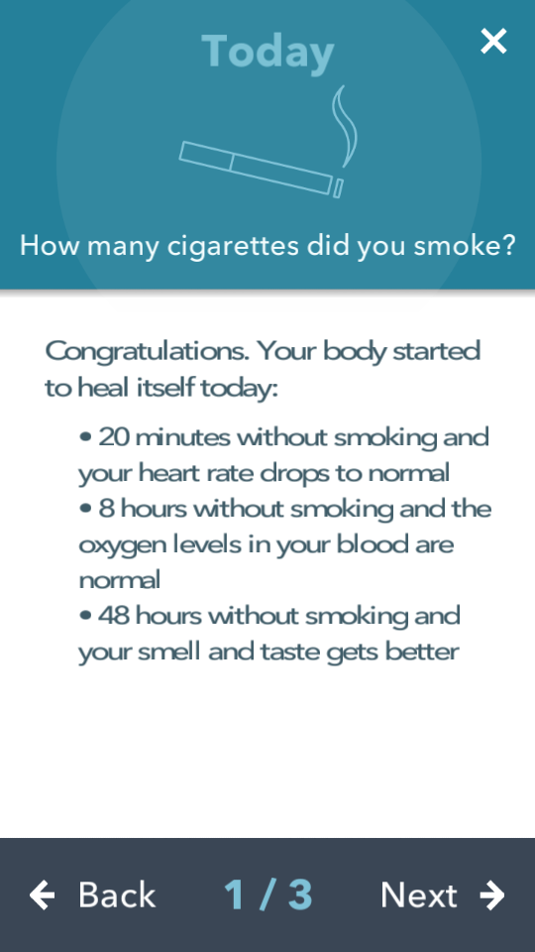
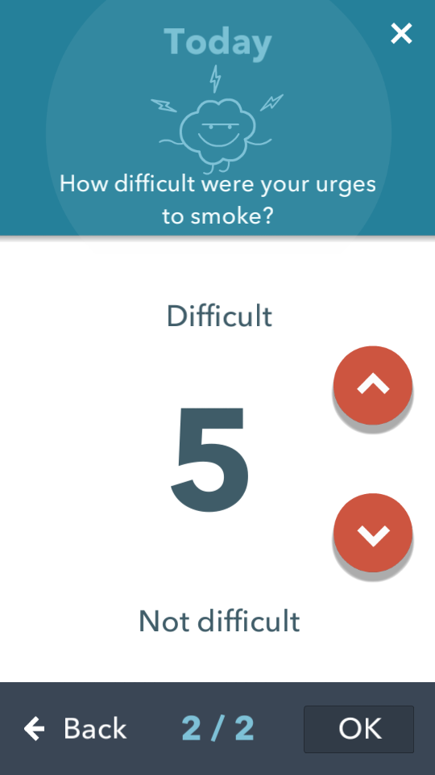
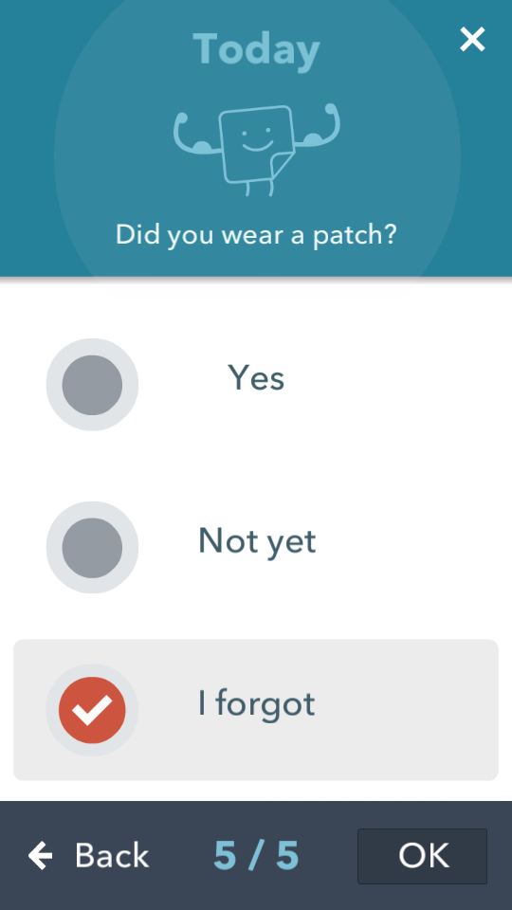
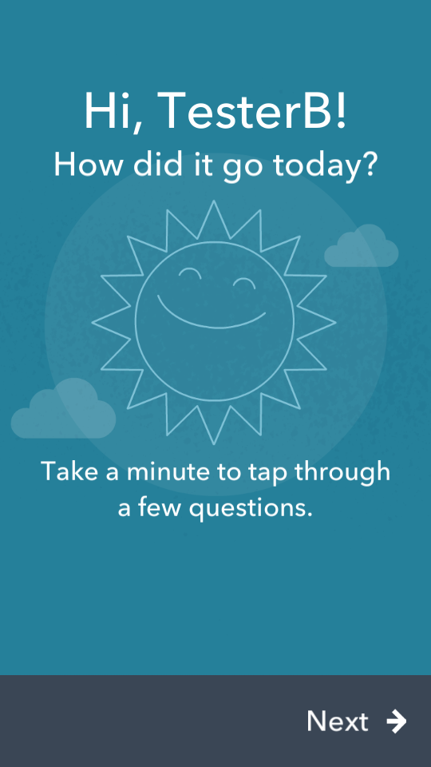
EMA Design Challenges
Challenges | (Preliminary) Solutions
Poor memory recall | More System-initiated notifications
Low Engagement | Predictable EMA prompts, branching logic
Assessment burden sensitivity | Limiting redundant questions based on context, adding relevant interventions
Notes:
if you want your app to be effective for this population, there are some unique design challenges that need to be addressed.
Those with chronic mental illness tend to display more cognitive deficits than the general population. This translates into more memory recall errors(Vilardaga), which makes it hard to know the contextual factors influencing behavior.
We believed EMAs would have more success with our target users if the app prompted it (a verbal discriminative stimulus).
2. We also anticipated lower response rates. Some of the known factors which negatively predict EMA response rates include more extreme emotional states, higher alcohol use, and smoking rates (Sokolovsky, Mermelstein, & Hedeker, 2014) – which are not anuncommon phenomena in our target users.
We wanted users to better anticipate when they would be notified to complete EMAs. We also customized feedback to users’ responses to EMAs with branching logic. We hoped this customization would create some novelty and better keep users attention. This also presented an opportunity to deliver an EMI based on which lessons they’ve learned so far.
3. Reducing the assessment burden to complete EMAs, which we thought our target users may be more sensitive to.
To avoid this, we limited asking certain questions, and tried to provide more tailored content for a sense of personalization.

Slide 7
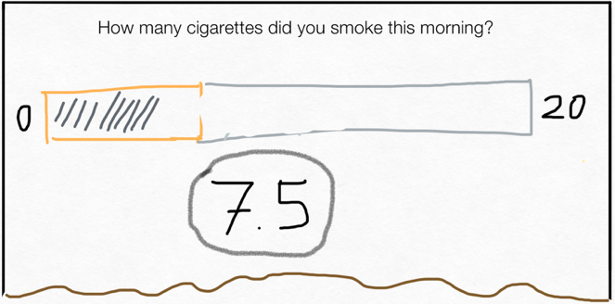
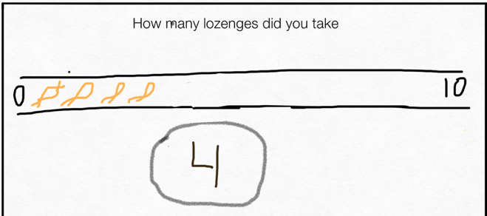
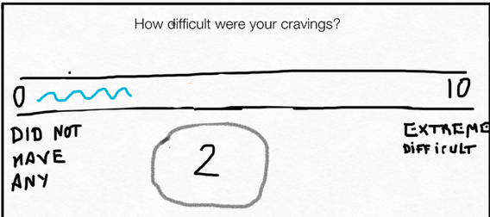
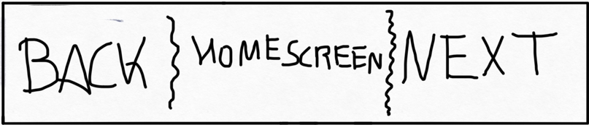
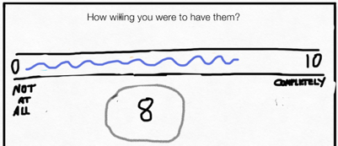
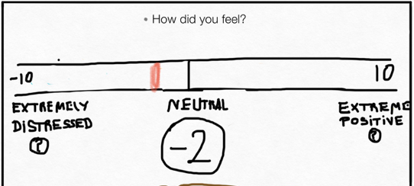
EMAs/EMIs Prototypes
Goals of L2Q EMAs
  Increase self-awareness
  Generalize skills
  Balancing usefulness with complexity
Graphic & Interaction Design
Iterative Development
  Prototyping
  Creating a minimum viable product (MVP)
Do you have the patch on?
Not yet Yes Forgot
Don’t forget to put the path on!
Your mood is very low
Should get in touch with your mental health provider?
Notes:
Before starting to create the app on the Android platform, we started with sketched paper prototypes of EMAs.
Design is a creative and iterative process, particular to the constraints of the goal in mind. The purpose of Learn to Quit’s EMA/EMI feature is to increase self-awareness (of smoking behavior), generalize skills, and balance the usefulness of app features with app complexity
We’ll discuss both the graphic and interaction design components.
When starting to build the app, we discussed the ideal core-app experience. With this we came up with a minimum viable product – whic distills the essential features required to meet our goals. It allows to simplify the user experience, and save on cost and time.

Slide 8
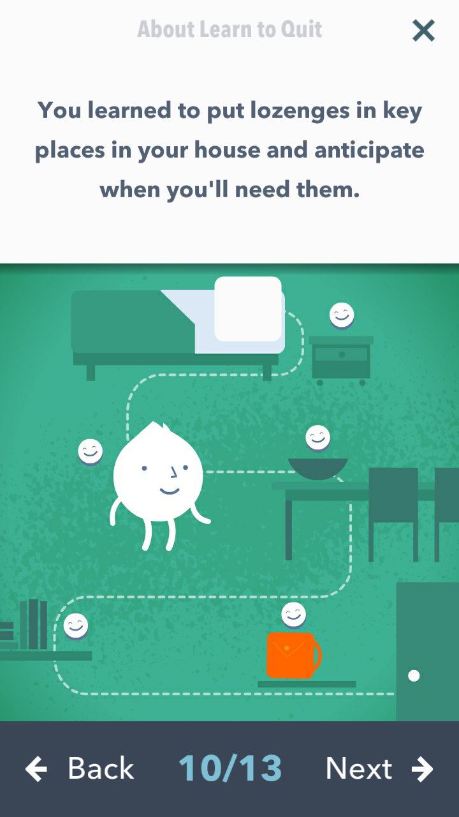
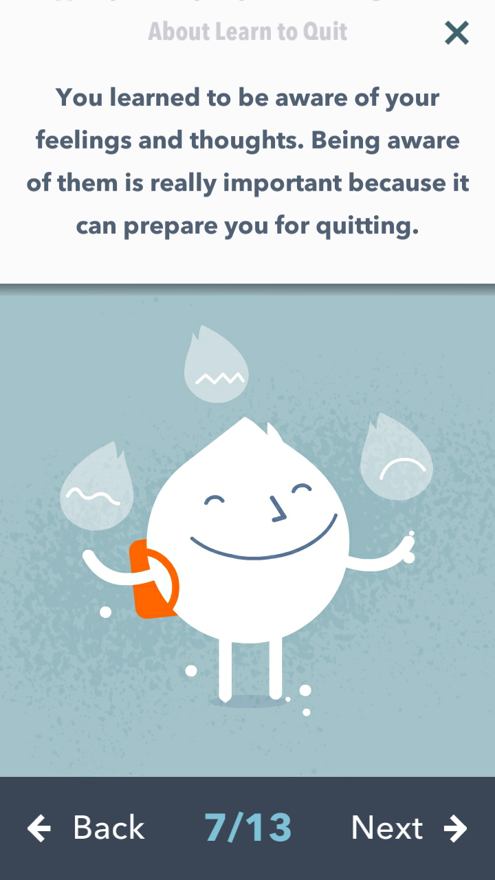
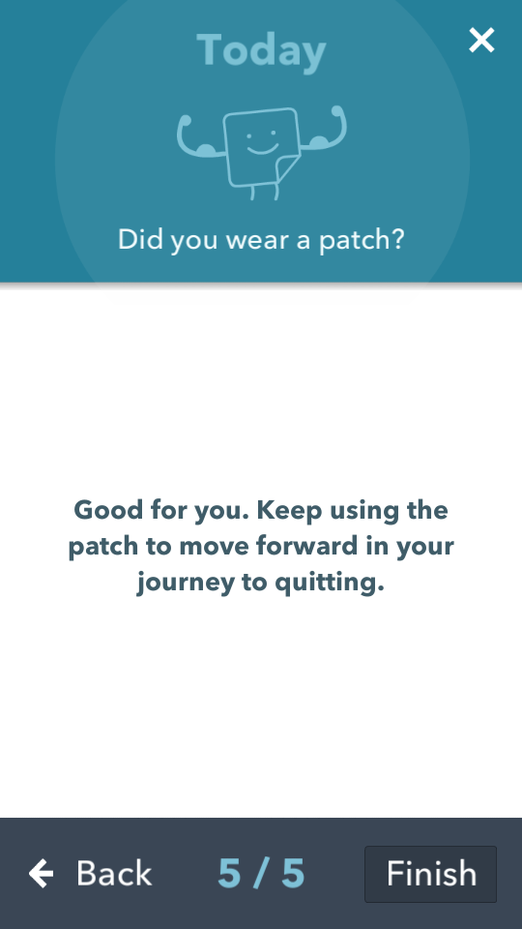
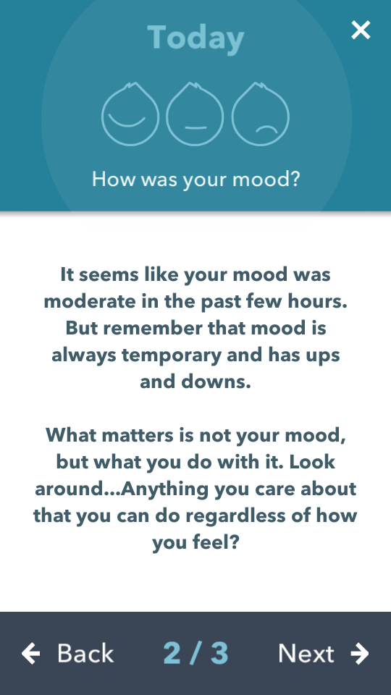
Integrating EMIs
Notes:
In order to integrate ACT intervention components, we paired some EMAs to recall earlier skills learned. If a user responded to an EMA with lower mood for instance, a screen would appear recalling lessons learned about mood. Same with cravings and NRT.
To further reinforce skill development and generalization, a learning module refresher would appear as part of the EMA once a week

Slide 9
EMA Visual Design Modifications
Minimal amount of text to reduce cognitive load
Visual acuity:
Big buttons
Large typeface
Clear anchoring to reduce
cognitive demands
Sufficient space
between buttons to
minimize effect of
tremors
Ability to go
back to reduce
cognitive demand
Screen count
Notes:
We made some changes in response to the earlier UX study of QuitPal and paper prototype of Learn to Quit.
Unlike the paper prototype EMA screen, which displayed all of the measurements at once, we decided each EMA question would have its own screen
For the graphic design piece, we wanted to reduce the cognitive demand and accommodate deficits in fine motor ability.

Slide 10
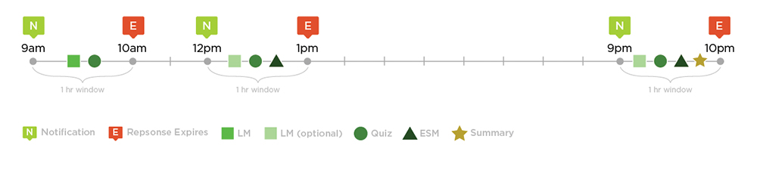
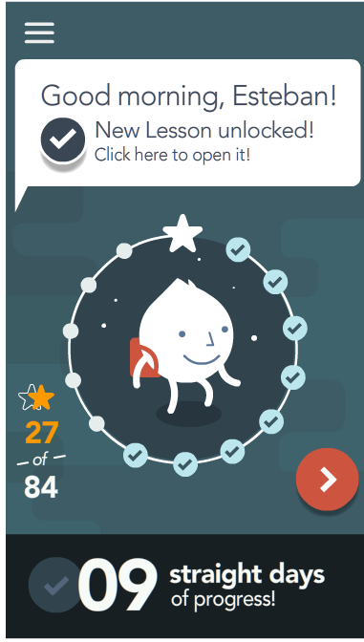
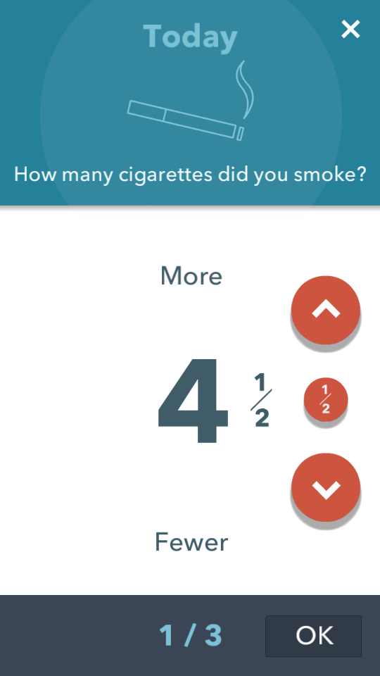
EMA/EMI Interaction Design In LtQ
Daily timing of EMAs
EMAs in context with app journey
Notes:
(1) EMA responses must be done within specified time frames. Originally (see image) we set up the EMA schedules at three times a day, and paired them with the daily lesson and quiz. We did this so users would have shorter period of behavior to recall, and it would provide personalized feedback more frequently.
We later decided to reduce it to two daily windows. This was done for practical considerations of time and money, and it also could reduce assessment burden. We only asked about how many cigarettes they smoked that day in the evening. This was done to reduce confusion among users. We were also reminded that tracking mood and willingness was ultimately more important
(2) EMAs sometimes differed depending on where the user was in the app journey. For instance, EMAs assessing nicotine patch and lozenge use didn’t show up until after the user completed the nicotine replacement lesson. We eventually got rid of tracking lozenges because it might be more difficult to do so.
Initially a faded schedule of some EMAs was proposed, but we decided against doing so because we wanted the EMAs to be at regular set intervals to allow users to better anticipate prompts.
We also added an EMI refresher from a lesson learned earlier in the day to recall previous learning.

Slide 11
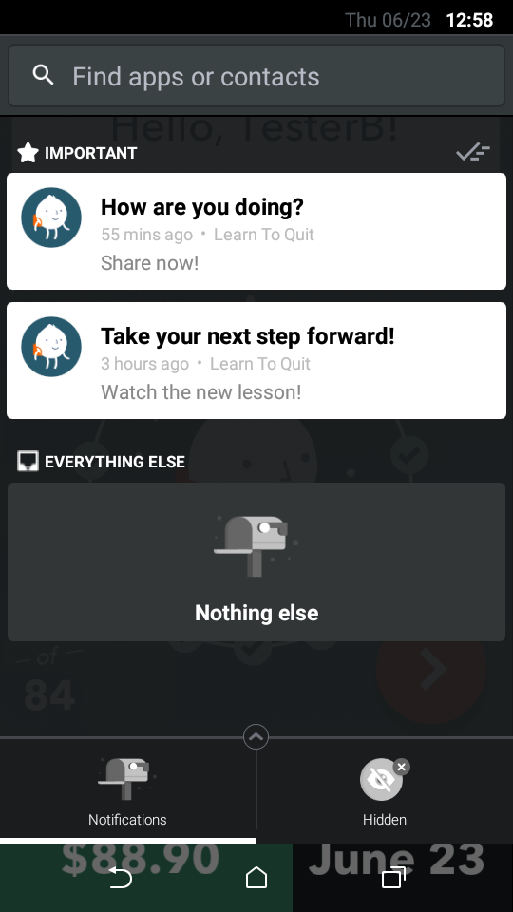
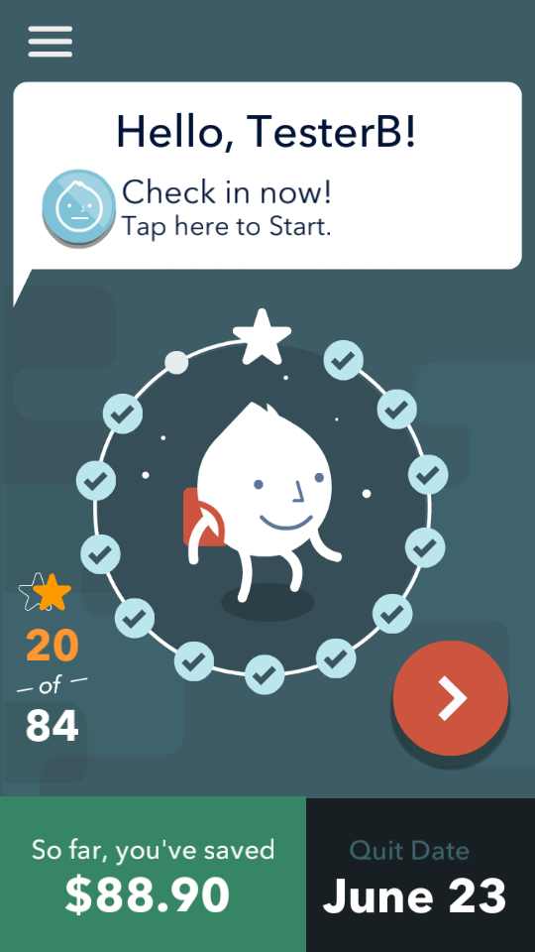
EMA System Initiated Stimuli
or
Notes:
So here are some screenshots of how the app cued users to complete EMAs. On the left, you have alerts which came up on the smartphone’s lock screen. On the right, once you’re in the app home screen, its main message prompts the user to complete the EMA
- this is what’s known in the industry as a Call to Action (CTA).

Slide 12
EMA/EMI Schedule
EMI Low
EMI Low
Mood EMA
Urge
EMA
Noon to 3pm
EMI Mod
EMI Mod
EMI High
EMI High
EMI Low
EMI Low
EMI Low
9pm to 12pm
Mood EMA
Urge
EMA
Cigs
EMA
EMI Mod
EMI Mod
EMI Mod
EMI High
EMI High
EMI High
Complete Schedule after Willingness and Patch Modules have been unlocked
EMI L
EMI Low
EMI Low
Mood EMA
Urge
EMA
Cigs
EMA
EMI M
EMI Mod
EMI Mod
EMI H
EMI High
EMI High
Notes:
Here’s a look at the branching for the EMAs we ended up with as a part of our most recent beta version.
This shows the steps the user takes through the EMAs, which then feedback an EMI. You’ll notice how they differ by time and the context of the app journey

Slide 13

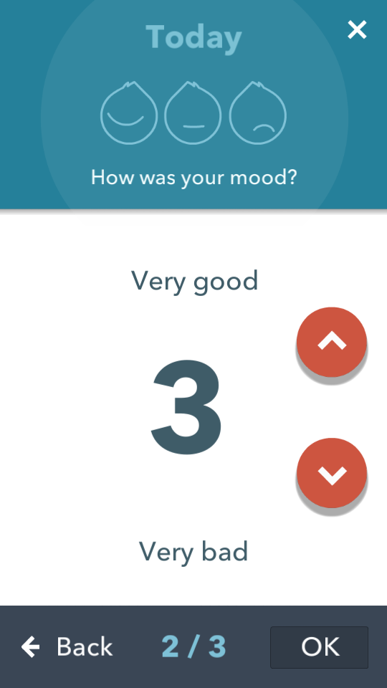
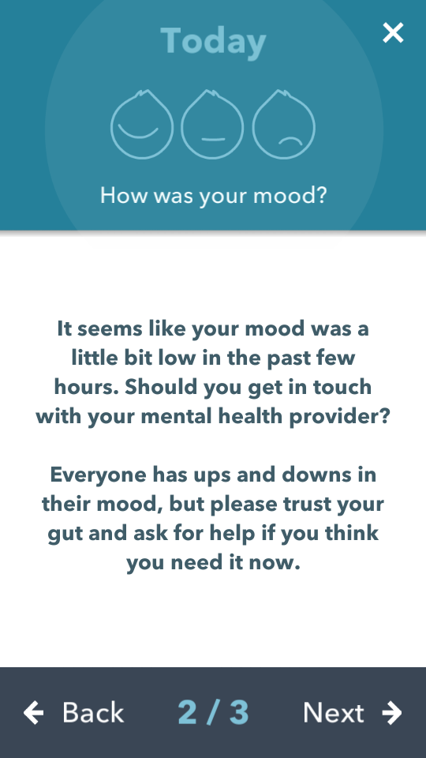
EMA/EMI Integration – Low Mood
Notes:
Here’s the user journey through the mood EMA. You’ll see that the message on the following screen changes depending on the rating

Slide 14
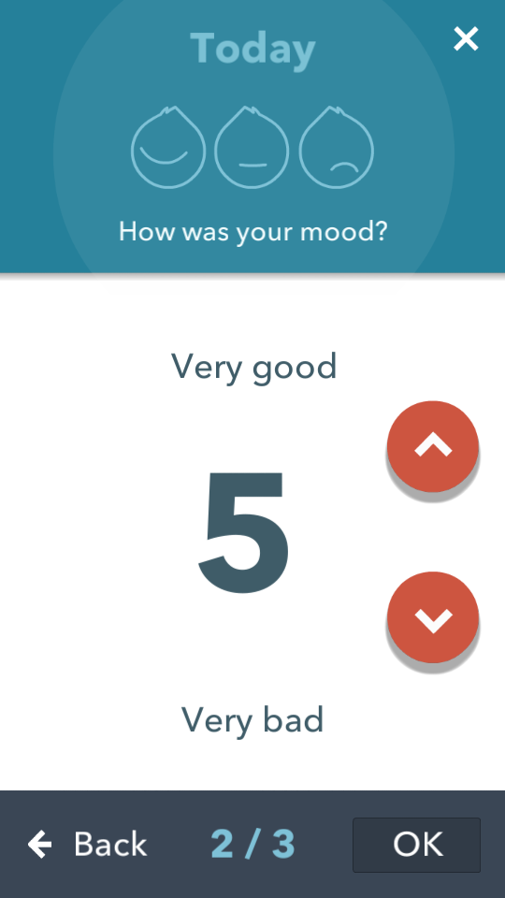
EMA/EMI Integration – Moderate Mood

Slide 15
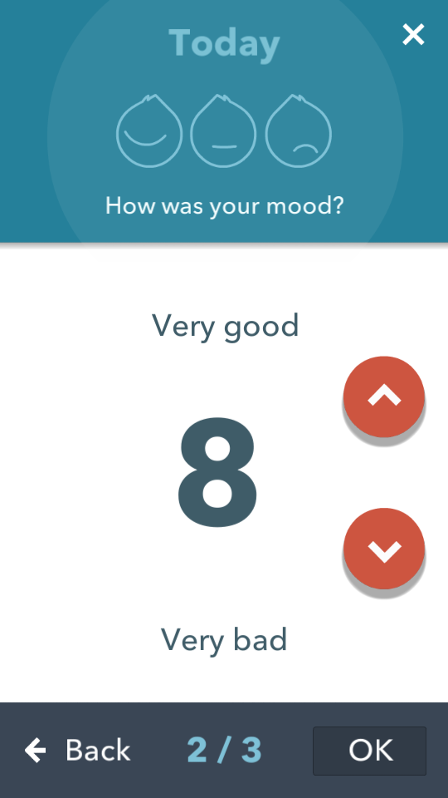
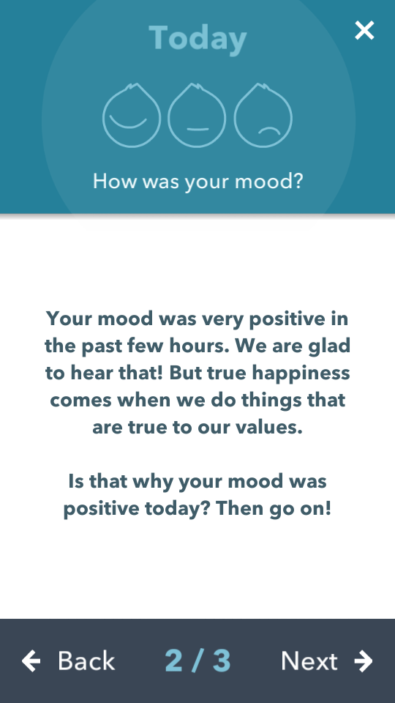
EMA/EMI Integration – High Mood

Slide 16
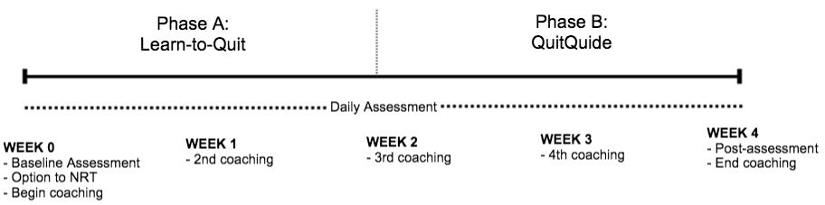
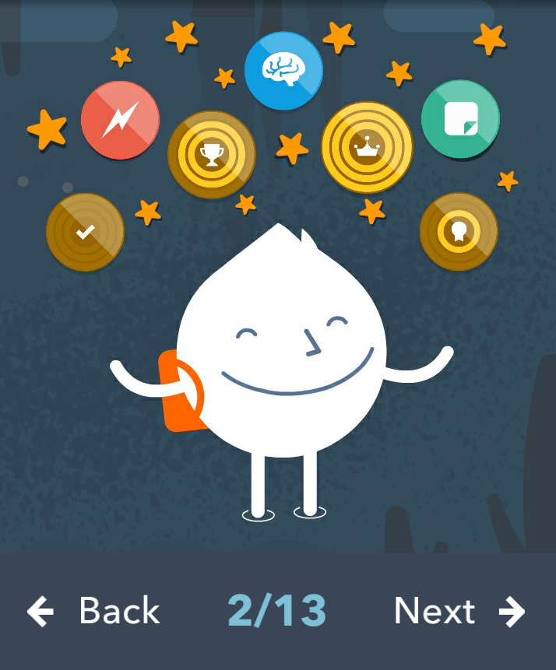
Preliminary evaluation of EMA/EMI integration
Secondary analysis of 7 single-case trials
  Longitudinal study (4 weeks)
  Randomized in either an AB assignment (n=5), or one-arm L2Q (n=2)
Notes:
This was a secondary analysis of 7 Single-Case trials we conducted using the Learn to Quit and QuitGuide apps, over the course of 4 weeks. Participants came in for a baseline assessment, weekly coaching sessions, and an in-depth user experience interview of each app.
Five were assigned to a two-arm condition, AB design where they were assigned to use each app for a randomized amount of time.

Slide 17
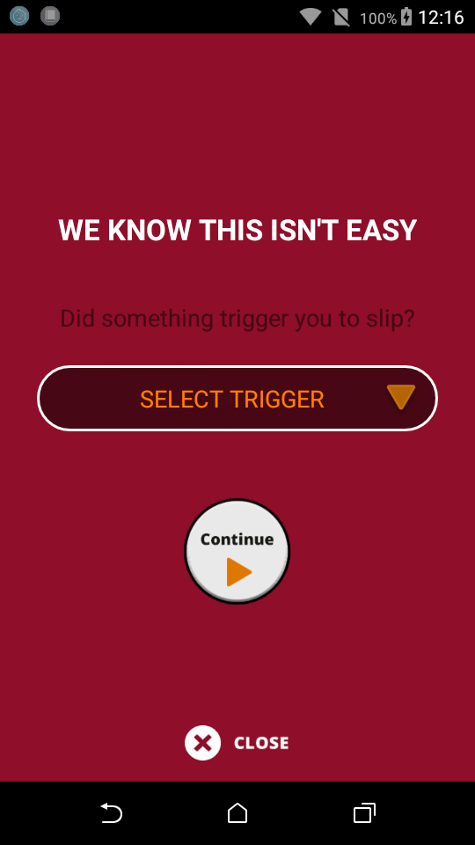
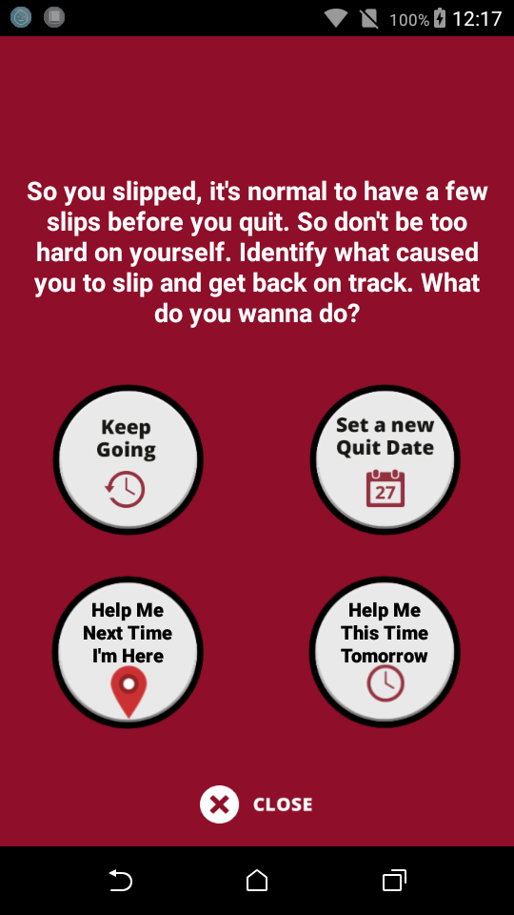
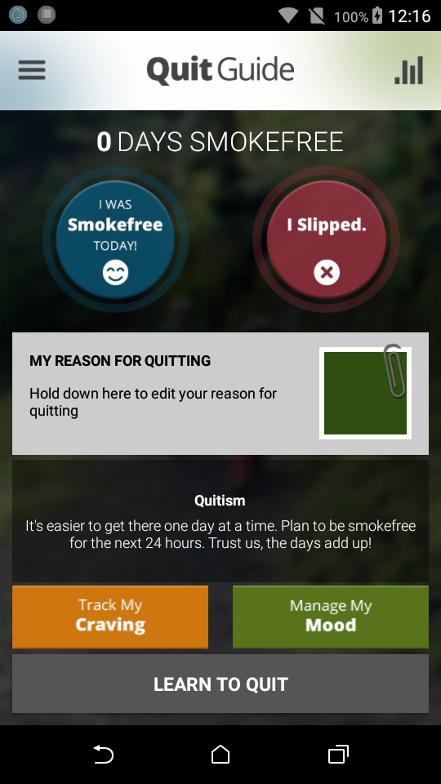

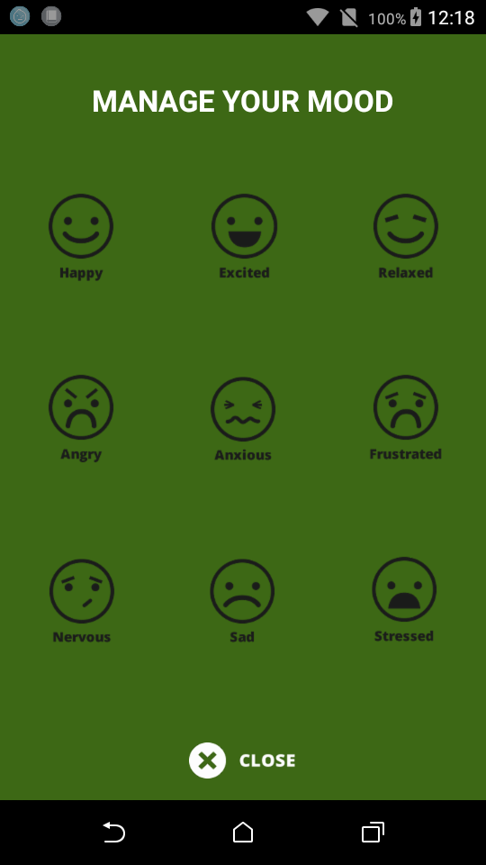
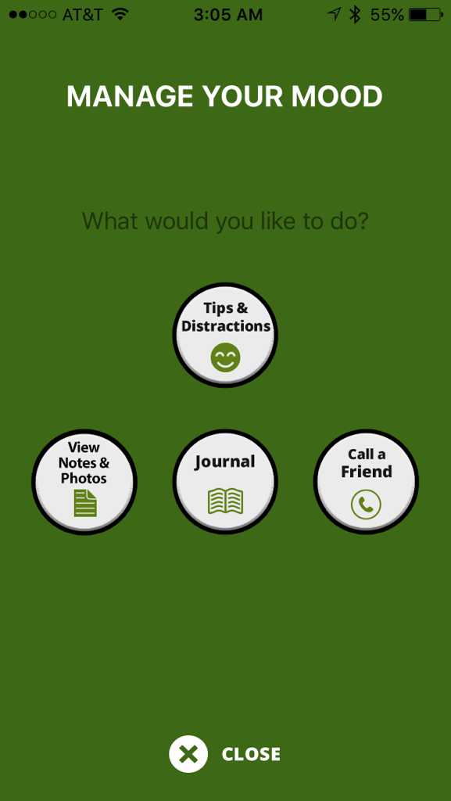
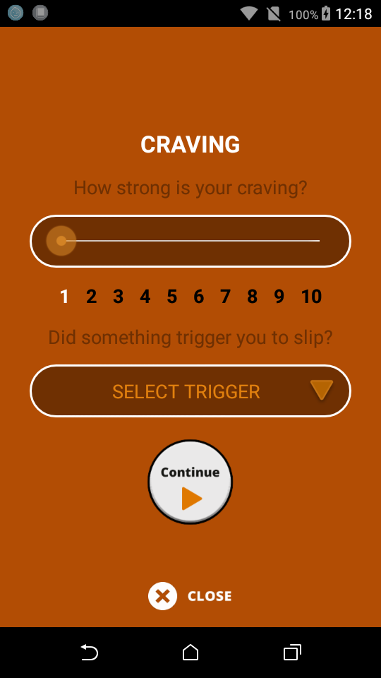
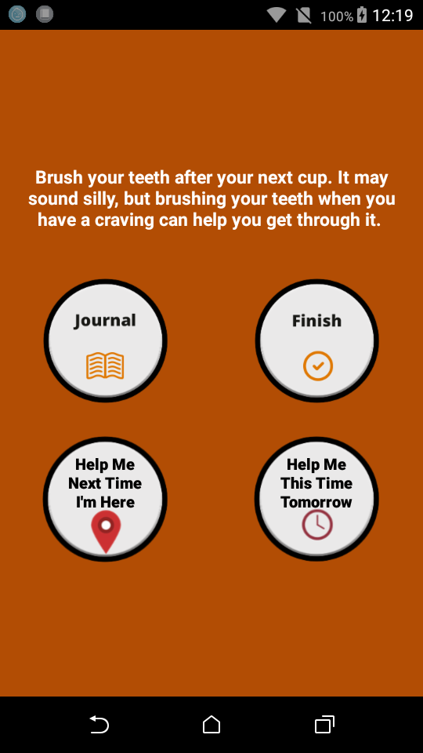
QuitGuide (comparsion app)
User-initiated EMAs
Tracking Cravings, Managing Mood
Notes:
QuitGuide, the comparison app, uses more user-initiated EMA features. It has options for users to track their cravings, mood, and whether they smoked that day or not. All of the tracking functions are right on the home page.

Slide 18
Participants
Participant | Age | Sex | Work status | Years Smok | Cigs/Day | Diagnosis | Years in MH
P101 | 45 | Female | Disabled | 13 | <10 | Schizophrenia | 25
P102 | 34 | Female | Working | 19 | 11-20 | Psychotic Disorder | 26
P103 | 55 | Male | Disabled | 45 | 11-20 | Bipolar | 35
P104 | 55 | Female | Disabled | 47 | <10 | Mood Disorder w/ Psychosis | 10
P106 | 31 | Male | Disabled | 16 | 21-30 | Major Depressive Disorder | 6
P107 | 50 | Male | Working | 33 | 11-20 | Mood Disorder w/ Psychosis | 35
P108 | 45 | Female | Working | 30 | 11-20 | Psychotic Disorder | 28
Notes:
Our participants are a group of seven who came from a local community mental health clinic
They had an average age of 45 years, mostly female, working, and with less than high school education. Nearly all our participants owned a mobile phone, and most used the internet regularly (defined as more than 4 times a week).
In terms of their health status, nearly all were diagnosed either with a psychotic disorder or had psychotic features, and over half had a mood disorder. All had moderate to severe nicotine dependence. We assessed cognitive functioning during the baseline. As you can see up here, all but two had scores below the standard with their average scores nearly 1 standard deviation(-0.88) below the mean for the general population.

Slide 19
Results - EMA responses & unlocks
 | System Initiated (Learn to Quit) |  | User Initiated (QuitGuide) |  | Smartphone Unlocks
 | Days Reported | Percentage | Days Reported | Percentage
P101 | 2/11 | 18.2% | 0/19 | 0.0% | n/a
P102 | 0/11 | 0.0% | 18/19 | 94.7% | n/a
P104 | 6/23 | 26.1% | 3/7 | 42.9% | 177
P106 | 5/22 | 22.7% | 3/8 | 37.5% | 874
P107 | 6/7 | 42.9% | 12/23 | 52.2% | 64
P103* | 5/30 | 16.67% | n/a | n/a | n/a
P108* | 11/18 | 61.11% | n/a | n/a
Average | 26.80% |  | 45.45%
*Those who just used Learn to Quit
QuitGuide’s EMA response rates were higher than Learn-to-Quit’s
Graphics and visual design was agreeable
Notes:
Here are some descriptive findings about EMA responses. So to our surprise it looks as though QuitGuide had overall higher engagement in its EMA responses. Nearly all participants who’d been randomized to the AB design had lower completion rates for Learn to Quit’s EMAs
For those participants we have unlock data for, there is quite a large range (r=810) but an indication of a somewhat frequent behavior.

Slide 20
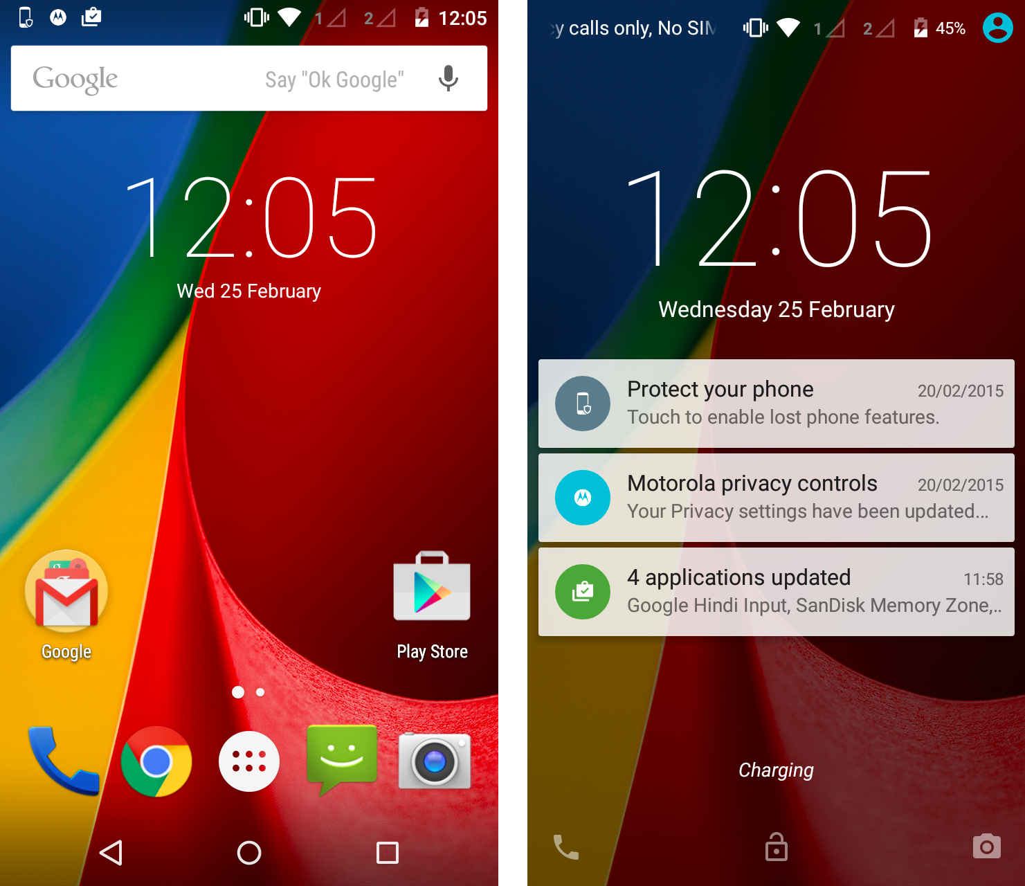
Discussion
LtQ system-initiated EMAs: Unsuccessful
  - Too short response windows
  - EMA alerts not immediately visible
QuitGuide’s user-initiated EMAs more effective, but less rigorous
More orientation and coaching to EMA
Notes:
We chose a system initiated EMA as an attempt to implement antecedent control and overcome problems with executive functioning in our population. However, we provided a too restrictive response window
Our system-initiated EMA triggers were not successful: Android hides them in the notifications tab.
Our graphic design was supported by direct participant observation and User Experience interviews. Our interaction design was more problematic:
Learn to Quit’s system initiated EMA schedule was consistent with EMA methodology, but too restrictive. In contrast, QuitGuide’s user-initiated EMA feature was less rigorous, but more effective:
Being oriented to EMA procedures with participants makes compliance more likely (Sokolovsky). We didn’t cover the EMA feature in the app during their initial coaching sessions (window would rarely be during appointments).

Slide 21
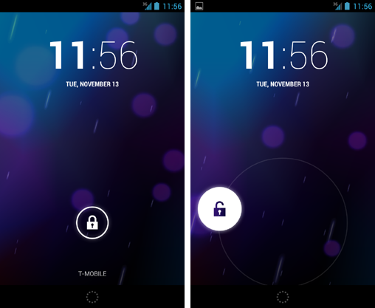
Design Opportunities
 | Learn to Quit | QuitGuide | Smartphone Unlocks
 | EMAs Reported | EMAs Reported
P104 | 6 | 3 | 177
P106 | 5 | 3 | 874
P107 | 6 | 12 | 64
TOTAL | 17 | 18 | 1115
Capitalizing on unlocking behavior: the Premack Principle
  Manual Android unlocking feature
Notes:
Applying the Premack Principle: Making a high frequent behavior (smartphone unlocks) contingent upon a low frequent behavior (self-initiated or system-initiated EMAs)
This can be achieved by modifying Android’s unlocking feature, as demonstrated by Zhang, Pina and Fogarty (2016).

Slide 22
Conclusions
Considerations of EMA design
  Graphic and interaction design
  Assessment burden
  Enhancing integration of EMA/EMI
Combining both user and system-initiated strategies
New opportunities for EMA innovation
Notes:
Designing EMAs in the context of EMIs requires close attention to both graphic and interaction design, assessment burden, and EMA/EMI enhancement
The current study pointed out to the need to combine user-initiated and system-initiated EMA strategies and highlighted new opportunities for EMA innovation

Slide 23
References
Ben-Zeev, D. (2012). Mobile Technologies in the Study, Assessment, and Treatment of Schizophrenia. Schizophrenia Bulletin, 38(3), 384–385. http://doi.org/10.1093/schbul/sbr179
Heron, K. E., & Smyth, J. M. (2010). Ecological momentary interventions: Incorporating mobile technology into psychosocial and health behaviour treatments. British Journal of Health Psychology, 15(1), 1–39. http://doi.org/10.1348/135910709X466063
Moggridge, B. (2007). Designing Interactions. MIT Press.
Shiffman, S., Stone, A. A., & Hufford, M. R. (2008). Ecological Momentary Assessment. Annual Review of Clinical Psychology, 4(1), 1–32. http://doi.org/10.1146/annurev.clinpsy.3.022806.091415
Sokolovsky, A. W., Mermelstein, R. J., & Hedeker, D. (2014). Factors Predicting Compliance to Ecological Momentary Assessment Among Adolescent Smokers. Nicotine & Tobacco Research, 16(3), 351–358. http://doi.org/10.1093/ntr/ntt154
Vilardaga, R., McDonell, M., Leickly, E., & Ries, R. (2015). Ecological Momentary Assessments: A Contextual Behavioral Approach to Studying Mindfulness and Acceptance in Psychosis. In B. Gaudiano (Ed.), Incorporating acceptance and mindfulness into the treatment of psychosis: Current trends and future directions (pp. 25-55). Oxford University Press, USA. Retrieved from http://cbsopenlab.com/wp-content/uploads/2012/10/26.-2014-Vilardaga-et-al-Contextual-Behavioral-Assex-in-Psychosis.pdf
Walton, G. M. (2014). The New Science of Wise Psychological Interventions. Current Directions in Psychological Science, 23(1), 73–82. http://doi.org/10.1177/0963721413512856

Slide 24
Thank You
Roger Vilardaga, PI -http://cbsopenlab.com/
Smashing Ideas - http://smashingideas.com/
Harborview Mental Health and Addiction Services (HMHAS) - http://www.uwmedicine.org/locations/addictions-program-harborview
Our Participants

